Slide 1




DIGITAL LITERACY
SKILLS
BASIC USERS

Slide 2
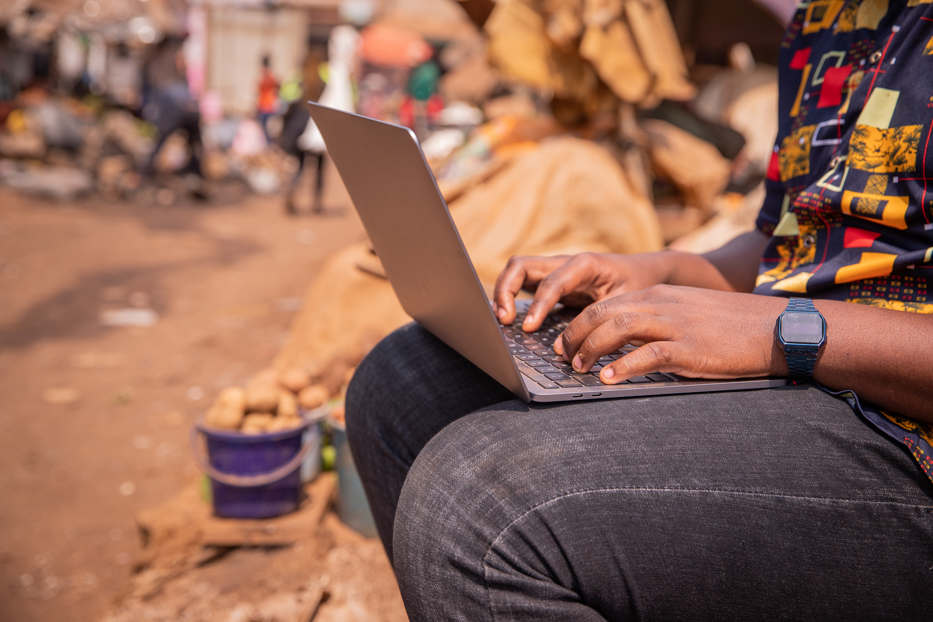
Module 3
Communication
and collaboration

Slide 3

2
Unit 2: Sharing through digital technologies

Slide 4
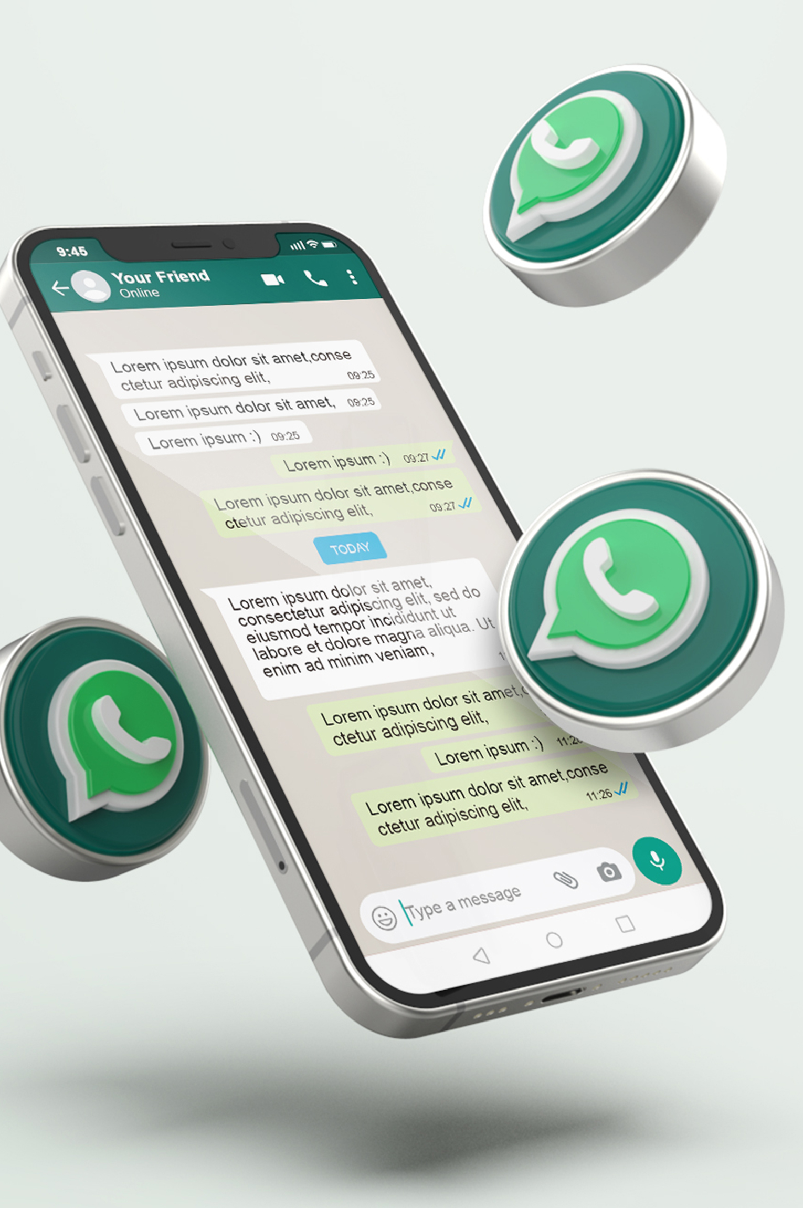
Simple file sharing tools
Send an email
Send a WhatsApp message

Slide 5

Sharing through Digital Technologies
The cloud has two distinct components:
Cloud computing
The service provider hosts applications that users run without installing those applications.
You can create documents without having to download and install the software.
Cloud computing saves space on your computer, the applications are always up to date, and you can run the applications from any device using your registered account.

Slide 6

Sharing through Digital Technologies
Cloud storage
Your files are stored in a secure and private location online.
It offers a reliable backup of information.
It allows for sharing of files, which allows collaborators to work on the same document at the same time.
It is updated with the latest files on your computer, if you are online.

Slide 7
Skills to practice
Share files and content.
Send an email with a file attached.
Send a WhatsApp message with a photo attached.
Open your Google drive and upload a file. Share the file with a friend.

Slide 8
All back covers should include
contact information of the section
producing the work.
© United Nations Children’s Fund (UNICEF) [month and year of publication]

